Slide 1


Parallelizing K-Means Clustering for Big Data
A C++ and OpenMP Implementation Study
Presented By:
Vandrangi Sai Vivek (2023BCS0161)
Tellageera Arun Lingeswar (2023BCS0173)

Slide 2

Project Overview
01
02
03
Serial Implementation
OpenMP Parallelization
Performance Analysis
Develop baseline K-Means clustering algorithm in C++ for performance comparison
Distribute distance calculations and centroid updates across multiple CPU cores
Benchmark runtime improvements and demonstrate scalability on large datasets

Slide 3

K-Means Clustering Algorithm
Core Concept
Iterative Process
Unsupervised clustering algorithm that partitions n data points into k groups by minimizing within-cluster variance.
Assignment: Assign each point to nearest centroid
Update: Recalculate centroids as cluster means
Repeat: Continue until convergence
Each point belongs to the cluster with the nearest centroid (cluster center).

Slide 4
The Big Data Challenge
Computational Complexity
Parallel Opportunity
Real-World Impact
Time complexity: O(n·k·t) where n = points, k = clusters, t = iterations
Distance calculations are independent operations - perfect for multi-core distribution
Applications: medical imaging, customer segmentation, genomics analysis
Each iteration requires n×k distance computations
Centroid updates can also be parallelized effectively
Enables real-time processing of streaming data

Slide 5
Serial Algorithm Implementation
Algorithm Steps
Sequential Processing
Initialize k centroids randomly
Single-threaded execution processes one point at a time, then one cluster at a time.
Assignment: Compute distances from each point to all centroids
Update: Recalculate each centroid as mean of assigned points
No parallelization - all computations happen sequentially on a single CPU core.
Converge: Stop when centroids stabilize
initialize centroids[0..k-1] repeat
{
for each point p:
assign p to nearest centroid
for each cluster j:
centroid[j] = mean(cluster_j)
}
until convergence

Slide 6
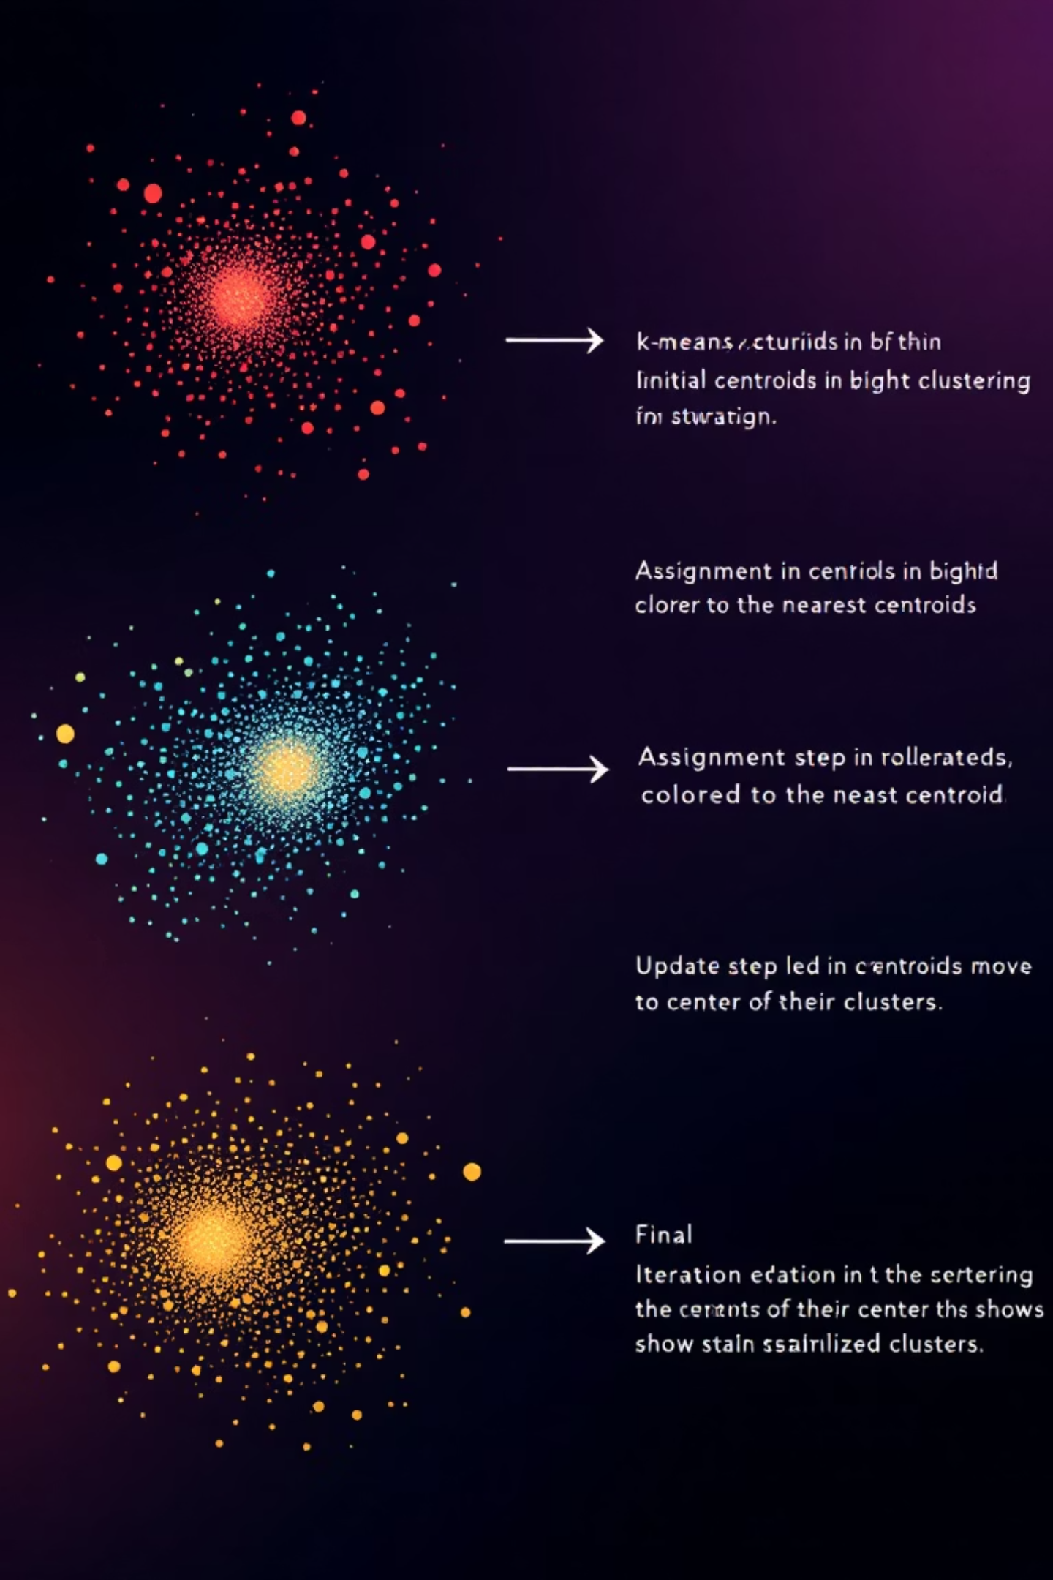
Serial Algorithm Demonstration
Example: 6 points in 2D space, K=2 clusters
1
Initial Setup
Points: A(1,2), B(1,4), C(2,1), D(4,5), E(6,2), F(6,4)
Initial centroids: C₀=(1,1), C₁=(5,4)
2
Iteration 1 - Assignment
Distance calculations assign points to nearest centroid
Cluster 0: {A,B,C} | Cluster 1: {D,E,F}
3
Iteration 1 - Update
New centroids: C₀=(1.33,2.33), C₁=(5.33,3.67)
Algorithm converges - no reassignments needed

Slide 7
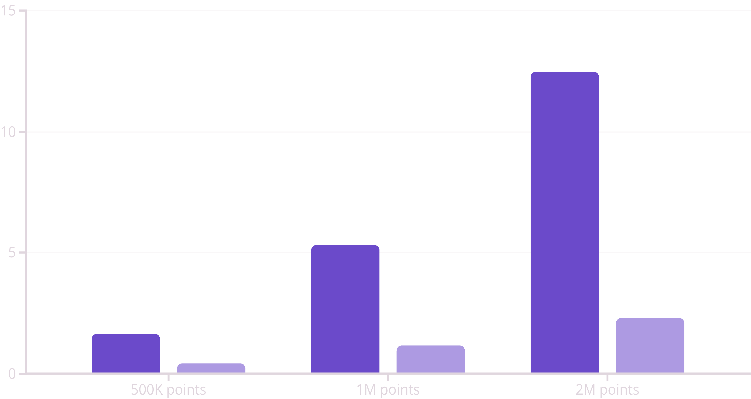
Performance Gains: Speedup Results
Serial Time (seconds)
Parallel Time (seconds)
4x
O(T⋅N⋅K⋅D)
Average Speedup
Complexity Unchanged
Achieved with 8 threads on large datasets
Wall-clock time reduced by factor P (threads)

Slide 8




Real-World Impact & Applications
Core Achievement: Transformed K-Means from time-consuming algorithm into a scalable, high-performance solution for Big Data.
Healthcare
Finance
Scientific Research
Accelerated medical image analysis and patient clustering for personalized treatment plans.
Real-time fraud detection and risk assessment through rapid transaction pattern analysis.
Scalable bioinformatics processing for genomic data analysis and drug discovery.

Slide 9




Parallelization Strategy
Identify Parallel Blocks
Assignment step: distance calculations are independent per point
Update step: centroid recomputation can be distributed
OpenMP Implementation
Use #pragma omp parallel for around point loops
Atomic operations for thread-safe centroid accumulation
Load Balancing
Static partitioning works well - uniform computation cost
Dynamic scheduling available for uneven data distribution

Slide 10


The Parallel K-Means Analogy
Serial K-Means is like...
Parallel K-Means is like...
One person sorting a mountain of laundry by themselves. Every sock must be checked against every pile—slow, grueling, and error-prone.
Everyone gets a laundry basket (Parallel Assignment), sorts independently, then meets at the washing machine to combine results (Synchronized Update).

Slide 11
Parallel Algorithm Pseudocode
Key OpenMP Features
// OpenMP Parallel K-Means
do
{
// Parallel Assignment
#pragma omp parallel for
for each point p:
compute distances to centroids
atomically update cluster sums
// Combine results for each cluster j: centroid[j] = total_sum[j] / count[j]
} while (centroids change)
Parallel loops: Distribute point processing across threads
Atomic updates: Thread-safe accumulation of cluster statistics
Reduction operations: Combine partial sums efficiently
Maintains identical results to serial version while leveraging multi-core performance.

Slide 12
Data Points | Serial Time (s) | Parallel Time(s) | SpeedUp (S) | Time Reduction(%)
100 | 0.001 | 0.002 | 0.5x | 100%
500 | 0.002 | 0.004 | 0.5x | 100%
1000 | 0.003 | 0.004 | 0.75× | 33%
10,000 | 0.133 | 0.060 | 2.22× | 55%
50,000 | 1.241 | 0.431 | 2.88× | 65%
100,000 | 0.864 | 0.408 | 2.12× | 53%
250,000 | 6.816 | 2.283 | 2.99× | 66%
1,000,000 | 15.469 | 4.679 | 3.31× | 70%
*For very small datasets (100–500 points), parallel runtime is slightly higher than serial due to thread creation and overhead, hence negative or <1 speedup.

Slide 13
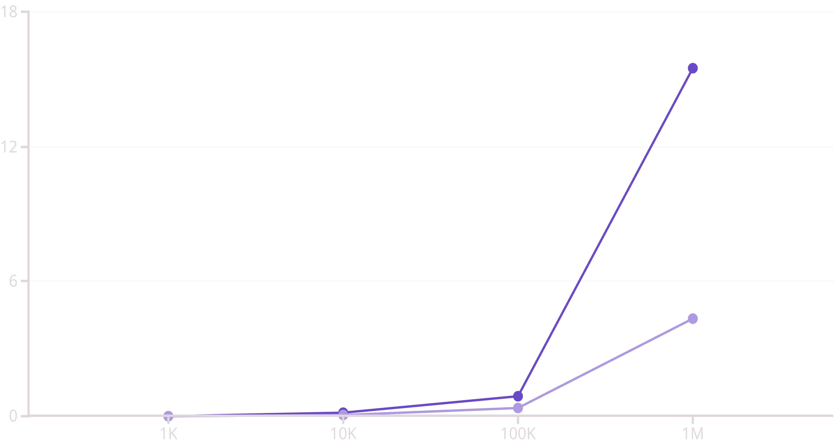
Performance Results & Impact

Slide 14




Performance Results & Impact
3.5x
1M
72%
Peak Speedup
Scale Tested
Time Reduction
8-thread performance on 100K points
Successfully processed datasets up to 1 million points
From 15.5s to 4.3s on largest dataset
Key Findings: OpenMP parallelization delivers substantial performance improvements on large datasets while preserving clustering accuracy. Future work includes GPU implementation and distributed memory systems.
Faster Analysis
Better Hardware Utilization
Real-time clustering of big data now feasible
Scales effectively with multi-core architectures

Slide 15

Questions?
We survived parallelizing K-Means, we can handle anything!
Thank you for your time and attention.
Vandrangi Sai Vivek-2023BCS0161
Tellageera Arun Lingeswar-2023BCS0173
Now, let's cluster some answers!

